Slide 1
Theory of Compilation
Lecture 17 – Dataflow Analysis (and more!)
Eran Yahav
www.cs.technion.ac.il/~yahave/tocs2011/compilers-lec17.pptx
Reference: Dragon 9, 12

Slide 2
Last week: dataflow
General recipe
design the domain
transfer functions
determine join operation (may/must?)
direction: forward/backward?
note initial values

Slide 3
Analyses Summary
 | Reaching Definitions | Available Expressions | Live Variables
L | (Var x Lab) | (AExp) | (Var)
 |  | ❒ | 
 |  |  | 
 |  | AExp | 
Initial | { (x,?) | x  Var} |  | 
Entry labels | { init } | { init } | final
Direction | Forward | Forward | Backward
F | { f: L  L | k,g : f(val) = (val \ k) U g }
f_{lab} | f_{lab}(val) = (val \ kill)  gen

Slide 4
Interprocedural Analysis
foo()
bar()
Call bar()
The effect of calling a procedure is the effect of executing its body

Slide 5
Call Graph
int (*pf)(int);
int fun1 (int x) {
if (x < 10)
return (*pf) (x+l); // C1
else
return x;
}
int fun2(int y) {
pf = &fun1;
return (*pf) (y) ; // C2
}
void main() {
pf = &fun2;
(*pf )(5) ; // C3
}
c1
fun1
c1
fun1
c2
fun2
c2
fun2
c3
main
c3
main
type based
more precise

Slide 6
Context Sensitivity
B1
main() {
for (i = 0; i < n; i++) {
t1 = f(0); // C1
t2 = f(42); // C2
t3 = f(42); // C3
X[i] = t1 + t2 + t3;
}
}
int f(int v)
return (v+1);
}
i=0
B7
B2
t3 = retval
t4 = t1+t2
t5 = t4+ t3
x[i] = t5
i = i + 1
if i<n goto L
B3
v = 0 // C1
B4
t1 = retval
v = 42 // C2
B5
t2 = retval
v = 42 // C3
B6
retval=v + 1 \\f

Slide 7
Solution Attempt #1
Inline callees into callers
End up with one big procedure
CFGs of individual procedures = duplicated many times
Good: it is precise
distinguishes different calls to the same function
Bad
exponential blow-up, not efficient
doesn’t work with recursion
main() { f(); f(); }
f() { g(); g(); }
g() { h(); h(); }
h() { ... }

Slide 8
Inlining
B1
main() {
for (i = 0; i < n; i++) {
t1 = f(0); // C1
t2 = f(42); // C2
t3 = f(42); // C3
X[i] = t1 + t2 + t3;
}
}
int f(int v)
return (v+1);
}
i=0
B7
B2
t4 = t1+t2
t5 = t4+ t3
x[i] = t5
i = i + 1
if i<n goto L
B3
t1 = 1
B4
t2 = 42 + 1
B5
t3 = 42 + 1

Slide 9
Solution Attempt #2
Build a “supergraph” = inter-procedural CFG
Replace each call from P to Q with
An edge from point before the call (call point) to Q’s entry point
An edge from Q’s exit point to the point after the call (return pt)
Add assignments of actuals to formals, and assignment of return value
Good: efficient
Graph of each function included exactly once in the supergraph
Works for recursive functions (although local variables need additional treatment)
Bad: imprecise, “context-insensitive”
The “unrealizable paths problem”: dataflow facts can propagate along infeasible control paths

Slide 10
Unrealizable Paths
foo()
zoo()
bar()
Call bar()
Call bar()

Slide 11
Interprocedural Analysis
begin
proc p() is¹
[x := a + 1]²
end³
[a=7]⁴
[call p()]⁵₆
[print x]⁷
[a=9]⁸
[call p()]⁹₁₀
[print a]¹¹
end
Extend language with begin/end and with [call p()]^{clab}_{rlab}
Call label clab, and return label rlab

Slide 12
IVP: Interprocedural Valid Paths
f₁
f₂
call_{q}
ret
f_{k-1}
f_{k}
f₃
(
)
f_{k-2}
enter_{q}
exit_{q}
f₄
f_{k-3}
f₅
IVP: all paths with matching calls and returns
And prefixes

Slide 13
Valid Paths
foo()
zoo()
bar()
(1
(2
Call bar()
Call bar()
)2
)1

Slide 14
Interprocedural Valid Paths
IVP set of paths
Start at program entry
Only considers matching calls and returns
aka, valid
Can be defined via context free grammar
matched ::= matched (_{i} matched )_{i} | ε
valid ::= valid (_{i} matched | matched
paths can be defined by a regular expression

Slide 15
The Join-Over-Valid-Paths (JVP)
vpaths(n) all valid paths from program start to n
JVP[n] = {←e₁, e₂, …, e→ (initial) (e₁, e₂, …, e) ∈ vpaths(n)}
JVP  JFP
In some cases the JVP can be computed
(Distributive problem)

Slide 16
Sharir and Pnueli ‘82
Call String approach
Blend interprocedural flow with intra procedural flow
Tag every dataflow fact with call history
Functional approach
Determine the effect of a procedure
E.g., in/out map
Treat procedure invocations as “super ops”
Notes:
Functional approach very similar to Cousot & Cousot

Slide 17
The Call String Approach
Record at every node a pair (l, c) where l ∈ L is the dataflow information and c is a suffix of unmatched calls
Use Chaotic iterations
To guarantee termination limit the size of c (typically 1 or 2)
Emulates inline (but no code growth)
Exponential in size of c

Slide 18
begin
proc p() is¹
[x := a + 1]²
end³
[a=7]⁴
[call p()]⁵₆
[print x]⁷
[a=9]⁸
[call p()]⁹₁₀
[print a]¹¹
end
[x0, a0]
a=7
9,[x8, a9]
5,[x0, a7]
[x0, a7]
call p⁵
proc p
9,[x8, a9]
[x8, a7]
5,[x0, a7]
call p⁶
x=a+1
9,[x10, a9]
5,[x8, a7]
[x8, a7]
print x
end
9,[x10, a9]
5,[x8, a7]
[x8, a7]
a=9
[x8, a9]
call p⁹
call p¹⁰
[x10, a9]
print a
(slide from Tom Reps)

Slide 19
10:[x0, a7]
4:[x0, a6]
begin⁰
proc p() is¹
if [b]² then (
[a := a -1]³
[call p()]⁴₅
[a := a + 1]⁶
)
[x := -2* a + 5]⁷
end⁸
[a=7]⁹ ; [call p()]¹⁰₁₁ ; [print(x)]¹²
end¹³
p
[x0, a0]
If( … )
10:[x0, a7]
a=7
[x0, a7]
a=a-1
Call p¹⁰
10:[x0, a6]
Call p⁴
10:[x-7, a6]
Call p¹¹
Call p⁵
4:[x-7, a6]
print(x)
4:[x-7, a6]
a=a+1
4:[x0, a6]
4:[x-7, a7]
x=-2a+5
4:[x, a]
4:[x-7, a6]
end
(slide from Tom Reps)

Slide 20
The Functional Approach
The meaning of a procedure is mapping from states into states
The abstract meaning of a procedure is function from an abstract state to abstract states
Notes:
The functional approach was introduced independently by Cousot and Sharir and Pnueli. Cousot used the term “relational” since the analysis computes a relation between input and output values. Both did not address the problem of complexity addressed Reps at el.
It was implemented in SLAM and expected to be released in DDK

Slide 21
λe.[x-2e(a)+5, a e(a)]
begin
proc p() is¹
if [b]² then (
[a := a -1]³
[call p()]⁴₅
[a := a + 1]⁶
)
[x := -2* a + 5]⁷
end⁸
[a=7]⁹ ; [call p()]¹⁰₁₁ ; [print(x)]¹²
end
p
[x0, a0]
If( … )
a=7
[x0, a7]
a=a-1
Call p¹⁰
Call p⁴
[x-9, a7]
Call p¹¹
[x-9, a7]
Call p⁵
print(x)
a=a+1
x=-2a+5
end
(slide from Tom Reps)

Slide 22
λe.[x-2e(a)+5, a e(a)]
begin
proc p() is¹
if [b]² then (
[a := a -1]³
[call p()]⁴₅
[a := a + 1]⁶
)
[x := -2* a + 5]⁷
end⁸
[read(a)]⁹ ; [call p()]¹⁰₁₁ ; [print(x)]¹²
end
p
[x0, a0]
If( … )
read(a)
[x0, a]
a=a-1
Call p¹⁰
Call p⁴
[x, a]
Call p¹¹
[x, a]
Call p⁵
print(x)
a=a+1
x=-2a+5
end
(slide from Tom Reps)

Slide 23
Functional Approach: Main Idea
Iterate on the abstract domain of functions from L to L
Two phase algorithm
Compute the dataflow solution at the exit of a procedure as a function of the initial values at the procedure entry (functional values)
Compute the dataflow values at every point using the functional values
Computes JVP for distributive problems

Slide 24
Meanwhile, IRL
new compilers for new languages
new compilers for old languages
e.g., Java->JavaScript
new uses of compiler technology
…

Slide 25
Google Web Toolkit
Compiler
Java
code
txt
Javascript
code
js
Frontend
(analysis)
Semantic
Representation
Backend
(synthesis)

Slide 26
GWT Compiler Optimization
public class ShapeExample implements EntryPoint {
private static final double SIDE_LEN_SMALL = 2;
private final Shape shape = new SmallSquare();
public static abstract class Shape {
public abstract double getArea();
}
public static abstract class Square extends Shape {
public double getArea() { return getSideLength() * getSideLength(); }
public abstract double getSideLength();
}
public static class SmallSquare extends Square {
public double getSideLength() { return SIDE_LEN_SMALL; }
}
public void onModuleLoad() {
Shape shape = getShape();
Window.alert("Area is " + shape.getArea());
}
private Shape getShape() { return shape; }
(source: http://dl.google.com/io/2009/pres/Th_1045_TheStoryofyourCompile-ReadingtheTeaLeavesoftheGWTCompilerforanOptimizedFuture.pdf)

Slide 27
GWT Compiler Optimization
public class ShapeExample implements EntryPoint {
public void onModuleLoad() {
Window.alert("Area is 4.0");
}
(source: http://dl.google.com/io/2009/pres/Th_1045_TheStoryofyourCompile-ReadingtheTeaLeavesoftheGWTCompilerforanOptimizedFuture.pdf)

Slide 28
Adobe ActionScript
First introduced in Flash Player 9, ActionScript 3 is an object-oriented programming (OOP) language based on ECMAScript—the same standard that is the basis for JavaScript—and provides incredible gains in runtime performance and developer productivity. ActionScript 2, the version of ActionScript used in Flash Player 8 and earlier, continues to be supported in Flash Player 9 and Flash Player 10.
ActionScript 3.0 introduces a new highly optimized ActionScript Virtual Machine, AVM2, which dramatically exceeds the performance possible with AVM1. As a result, ActionScript 3.0 code executes up to 10 times faster than legacy ActionScript code.
(source: http://www.adobe.com/devnet/actionscript/articles/actionscript3_overview.html)

Slide 29
Adobe ActionScript
Compiler
AS
code
txt
AVM
bytecode
swf
Frontend
(analysis)
Semantic
Representation
Backend
(synthesis)

Slide 30
Adobe ActionScript: Tamarin
The goal of the "Tamarin" project is to implement a high-performance, open source implementation of the ActionScript™ 3 language, which is based upon and extends ECMAScript 3rd edition (ES3). ActionScript provides many extensions to the ECMAScript language, including packages, namespaces, classes, and optional strict typing of variables. "Tamarin" implements both a high-performance just-in-time compiler and interpreter. The Tamarin virtual machine is used within the Adobe® Flash® Player and is also being adopted for use by projects outside Adobe. The Tamarin just-in-time compiler (the "NanoJIT") is a collaboratively developed component used by both Tamarin and Mozilla TraceMonkey. The ActionScript compiler is available as a component from the open source Flex SDK.

Slide 31
Mozilla SpiderMonkey
SpiderMonkey is a fast interpreter
runs an untyped bytecode and operates on values of type jsval—type-tagged double-sized values that represent the full range of JavaScript values.
SpiderMonkey contains two JavaScript Just-In-Time (JIT) compilers, a garbage collector, code implementing the basic behavior of JavaScript values…
SpiderMonkey's interpreter is mainly a single, tremendously long function that steps through the bytecode one instruction at a time, using a switch statement (or faster alternative, depending on the compiler) to jump to the appropriate chunk of code for the current instruction.
(source: https://developer.mozilla.org/En/SpiderMonkey/Internals)

Slide 32
Mozilla SpiderMonkey: Compiler
consumes JavaScript source code
produces a script which contains bytecode, source annotations, and a pool of string, number, and identifier literals. The script also contains objects, including any functions defined in the source code, each of which has its own, nested script.
The compiler consists of
a random-logic rather than table-driven lexical scanner
a recursive-descent parser that produces an AST
a tree-walking code generator
The emitter does some constant folding and a few codegen optimizations
(source: https://developer.mozilla.org/En/SpiderMonkey/Internals)

Slide 33
Mozilla SpiderMonkey
SpiderMonkey contains a just-in-time trace compiler that converts bytecode to machine code for faster execution.
The JIT works by detecting commonly executed loops, tracing the executed bytecodes in those loops as they run in the interpreter, and then compiling the trace to machine code.
See the page about the Tracing JIT for more details.
The SpiderMonkey GC is a mark-and-sweep, non-conservative (exact) collector.
(source: https://developer.mozilla.org/En/SpiderMonkey/Internals)

Slide 34
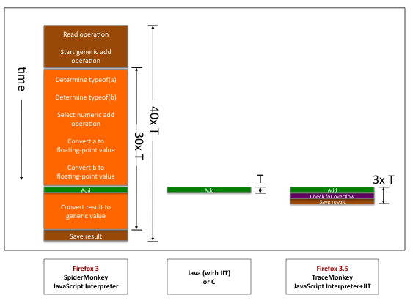
Mozilla TraceMonkey
(source: http://hacks.mozilla.org/2009/07/tracemonkey-overview/)

Slide 35
Mozilla TraceMonkey
Goal: generate type-specialized code
Challenges
no type declarations
statically trying to determine types mostly hopeless
Idea
run the program for a while and observe types
use observed types to generate type-specialized code
compile traces
Sounds suspicious?

Slide 36
Mozilla TraceMonkey
Problem 1: “observing types” + compiling possibly more expensive than running the code in the interpreter
Solution: only compile code that executes many times
“hot code” = loops
initially everything runs in the interpreter
start tracing a loop once it becomes “hot”

Slide 37
Mozilla TraceMonkey
Problem 2: past types do not guarantee future types… what happens if types change?
Solution: insert type-checks into the compiled code
if type-check fails, need to recompile for new types
code with frequent type changes will suffer some slowdown

Slide 38
Mozilla TraceMonkey
function addTo(a, n) {
for (var i = 0; i < n; ++i)
a = a + i;
return a;
}
var t0 = new Date();
var n = addTo(0, 10000000);
print(n);
print(new Date() - t0);
a = a + i; // a is an integer number (0 before, 1 after)
++i; // i is an integer number (1 before, 2 after)
if (!(i < n)) // n is an integer number (10000000)
break;
trace_1_start:
++i; // i is an integer number (0 before, 1 after)
temp = a + i; // a is an integer number (1 before, 2 after)
if (lastOperationOverflowed())
exit_trace(OVERFLOWED);
a = temp;
if (!(i < n)) // n is an integer number (10000000)
exit_trace(BRANCHED);
goto trace_1_start;

Slide 39
Mozilla TraceMonkey
System | Run Time (ms)
SpiderMonkey (FF3) | 990
TraceMonkey (FF3.5) | 45
Java (using int) | 25
Java (using double) | 74
C (using int) | 5
C (using double) | 15

Slide 40
Static Analysis Tools
Coverity
SLAM
ASTREE
…

Slide 41
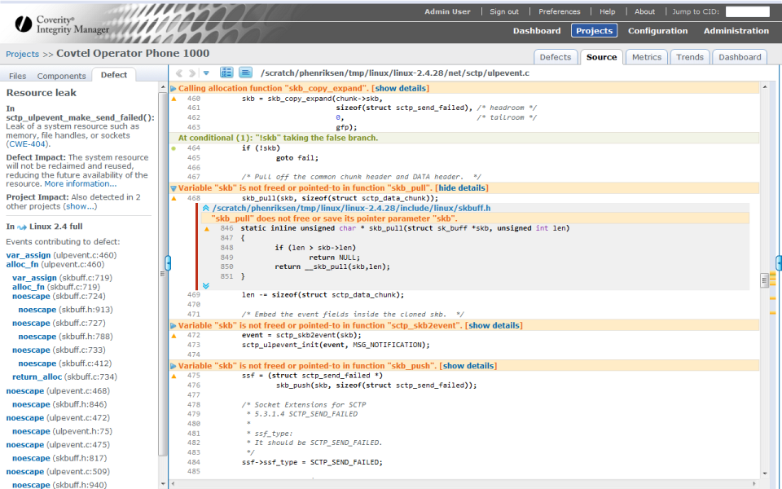

Slide 42
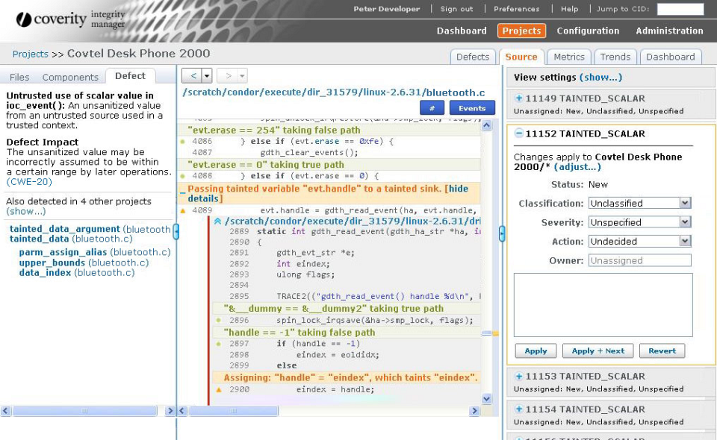

Slide 43
Lots and lots of research
Program Analysis
Program Synthesis
…
Next semester
Project –contact me if you’re interested
Advanced course in program analysis

Slide 44
THE END

