Slide 1
VEX: Vetting Browser Extensions For Security Vulnerabilities
Sruthi Bandhakavi Samuel T. King P. Madhusudan Marianne Winslett
University of Illinois at Urbana Champaign
fsbandha2,kingst,madhu,winslettg@illinois.edu
Presented by Doron Tromer

Slide 2
Introduction
What is VEX in a few words ?
A framework for highlighting potential security
vulnerabilities in browser extensions by applying
static information-ﬂow analysis to the JavaScript
code used to implement extensions.

Slide 3
Browser Extensions
What are they?
A browser extension is a computer program that extends the functionality of a web browser in some way.
Extensions can be used to modify the behavior of existing features of the application or add entirely new features.
Extensions are especially popular with Firefox, because Mozilla developers intend for the browser to be a fairly minimalistic application in order to reduce software bloat and bugs, while retaining a high degree of extensibility.

Slide 4
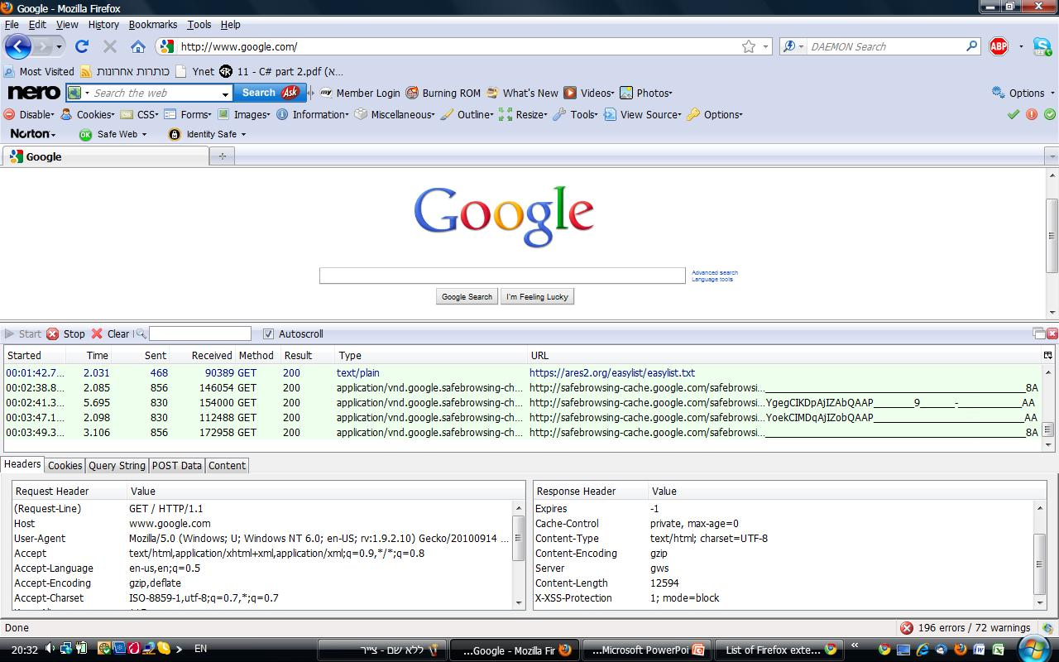
Mozilla Firefox Extensions
Extension technologies: HTML, CSS, DOM, JavaScript, XPCOM, XPConnect, XPI, XUL, Mozilla JetPack
Uses of extensions in Firefox:
  adding features - RSS readers, bookmark organizers, toolbars, FTP, Firebug, HttpFox
  modifying how the user views web pages – Adblock, Greasemonkey
Plugins - Acrobat Reader, Flash Player, Windows Media Player

Slide 5
Mozilla privilege levels
Page - for web pages displayed in the browser’s content window.
restrictive - a page loaded from site x cannot access content from sites other than x
Chrome - for elements belonging to Firefox and its extensions. Gives access to:
  all browser states and events
  OS resources
  all web pages
  Extensions have full chrome privileges by using an API called the XPCOM Components to extension JavaScript, thereby allowing the extensions to have access to all the resources Firefox can access.

Slide 6
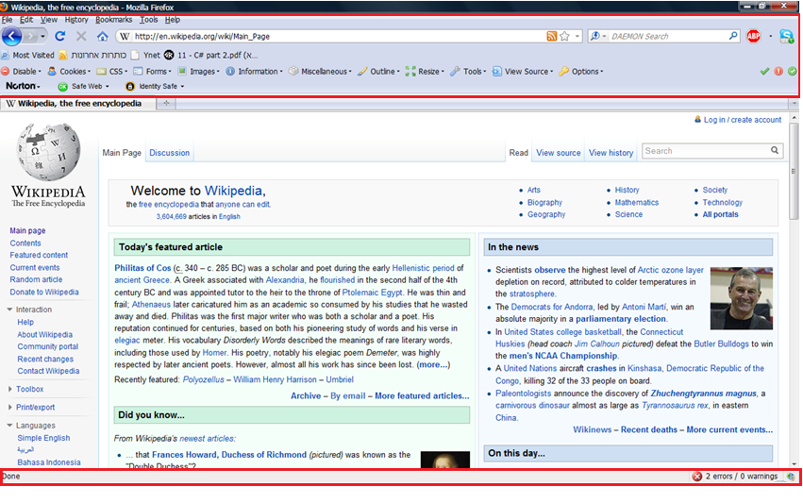
Mozilla privilege levels – cont.
Chrome
Page

Slide 7
privilege issues
Extensions can:
Access objects that run with page privileges and interact with page content.
Access objects that run with full chrome privileges.
Include user interface components via a chrome document, which also runs with full chrome privileges: window.content.document.
Thus, it can Lead to execution of remote code in privileged context, e.g. RSS reader extension takes the content of the RSS feed (HTML code) and insert it into the extension window.

Slide 8
Vulnerabilities in Browser Extensions
Extensions might be malicious and exploit the full privileges.
But even extensions written with benign intent can have subtle vulnerabilities that expose the user to a disastrous attack from the web.
  mostly by injecting JavaScript into a data item that is executed by the extension under full browser privileges.
  Doing so attackers can:
  take over the browser
  steal cookies or protected passwords
  compromise conﬁdential information
  hijack the host system

Slide 9
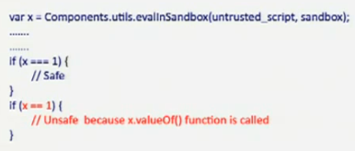
What is done today regarding these vulnerabilities
Mozilla provides a set of security primitives to extension developers
  the goal: reducing the attack surface for extensions.
  disadvantages: discretionary primitives, difﬁcult to understand and use correctly.
    Example: evalInSandbox (text, sandbox)

Slide 10
What is done today regarding these vulnerabilities – cont.
The research community propose dynamic techniques such as SABRE system
  the goal: improving the security of extensions.
  how is it done: The SABRE system tracks JavaScript objects to prevent extensions from accessing sensitive information unsafely (using security labels for every JavaScript object inside the browser).
  pros: SABRE can prevent potentially malicious ﬂows from both exploited extensions and from malicious extensions.
  cons:
    overhead (SunSpider - 6.1x, V8 JavaScript - 2.36x).
    security violation notiﬁcation: users must determine if a particular ﬂow is malicious or benign. Determining whether extensions are malicious or harbor security vulnerabilities is a hard problem

Slide 11
Assumptions in VEX
The developer isn’t malicious, but he could write incorrect code that contains vulnerabilities.
There are no bugs in the browser itself.
There are no bugs in other browser extensibility mechanisms, such as plug-ins.

Slide 12
Attack models considered
Attacks that originate from web sites. The attacker can send arbitrary HTML and JavaScript to the user’s browser, that might lead to code injection or privilege escalation through buggy extensions.
In the second model some web sites are considered trusted.

Slide 13
Points of attack
VEX focuses on vulnerable points for code injection and privilege escalation attacks:
Eval: interprets string data as JavaScript and executes it dynamically.
InnerHTML: each HTML element for a page has an innerHTML property that defines the text that occurs between that element’s tags. Extensions can change DOM (document object model) elements, or add new ones.
EvalInSandbox: execution of JavaScript in the extension’s context with restricted privileges.
WrappedJSObject: lets the extension access modiﬁed properties of the document object, even when automatic wrapping is on.

Slide 14
Information flow
A variable A is said to depend on another variable B in a procedure if there is a path such that the value of B can cause the value of A to change
  we also say that there is a flow from variable B to variable A
types of dependencies:
  strongly dependent: A = B + 1
  weakly dependent: if (condition) A = B + 1
  conditionally dependent: if (B > 0) A = 0
Information Flow Analysis (also called variable dependency analysis) is a study of the interdependencies of the program variables

Slide 15
Suspicious ﬂow patterns tracked by VEX
From content document data to eval.
From content document data to innerHTML.
From Resource Description Framework (RDF) data to innerHTML.
EvalInSandbox return objects used improperly by code running with chrome privileges.
WrappedJSObject return object used improperly by code running with chrome privileges.
These flows:
Don’t always result in a vulnerability.
Are not all of the possible extension security bugs.

Slide 16

An example for a suspicious ﬂow pattern
A flow from content document data to eval
Wikipedia Toolbar, up to version 0.5.9

Slide 17
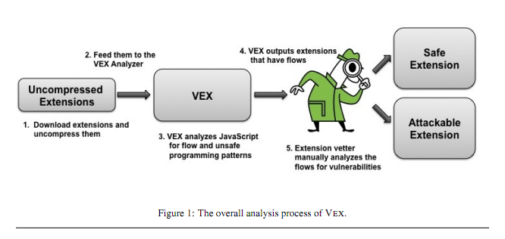
VEX’s work flow scheme

Slide 18
VEX’s anticipated contribution
Such ﬂow patterns may occur in only a few of the extensions that use these constructs.
Mozilla offers an open-source automatic tool to help with reviews (see https://addons.mozilla.org/en-US/firefox/pages/validation)
  it just greps for strings that indicate dangerous patterns.
  then the reviewer needs to manually check all of the suspect extensions.
  this checking is difficult and error-prone.
  VEX is designed to help vetting the ﬂows automatically , greatly reducing the number of extensions that need to be manually reviewed.

Slide 19
Static information ﬂow analysis
VEX is a general explicit information ﬂow static analysis tool
Computes ﬂows between any source and sink.
Tracks the precise dependencies of ﬂows from variables to objects created in the JavaScript extension.
This is a difficult task:
  large number of objects and functions.
  there are program defined objects as well as objects of DOM and of the extension (using XPCOM components)
  the objects are dynamic. new object properties can be created dynamically at run-time.
  functions are objects in JavaScript, they can be created, redefined dynamically, and passed as parameters.

Slide 20
Abstract Heaps
The analysis uses an abstract heap (AH)
the analysis keeps track of one abstract heap at each program point.
VEX creates a node for every:
  object
  function
  Property
Ignores the exact primitive values in the heap.
The AH records explicit-ﬂow dependencies to heap nodes.

Slide 21




Abstract Heaps – cont.
A definition: Pvar – A set of all the program variables
An abstract heap is a tuple: (ns,n,d,fr,dm,tm)
ns - a set of heap locations.
- represents the current node.
- represents the subset of program variables that ﬂow in to the current node n.
- encodes the pointers representing properties (ﬁelds).
  What does mean?

Slide 22




Abstract Heaps – cont.
- a relation that denotes a dependency map.
  What does mean?
- a “this-map” relation, which is actually the relation of a function.
  What does mean?

Slide 23
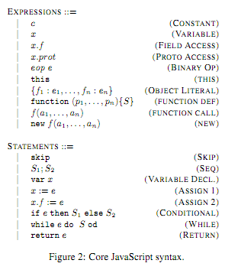
A core subset of JavaScript
Reﬂects the aspects of JavaScript, omitting certain features (such as eval)

Slide 24


The rules
Big step operational semantics on abstract heaps:
A relation
  prog - an program expression or statement
  - the initial abstract heap
  - the abstract heap obtained from the complete evaluation of prog starting from the heap
This resulting heap, in every iteration, will be merged with the current heap, conservatively taking the union of dependencies.

Slide 25
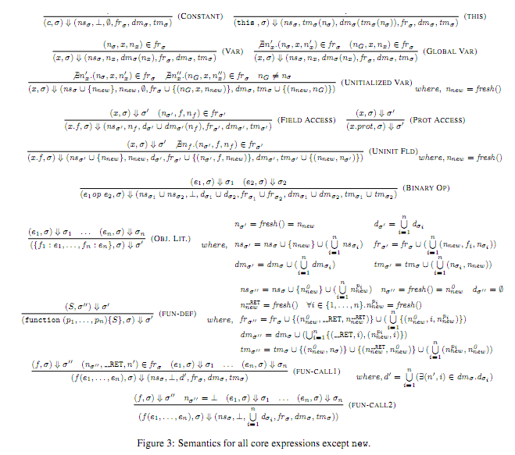
Evaluating expressions

Slide 26
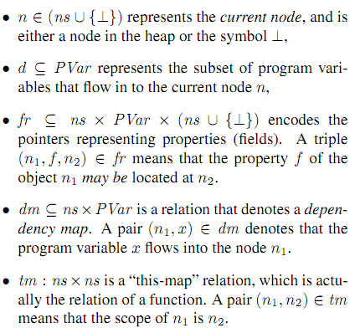

Evaluating expressions – cont.
What happens to the AH when
evaluating a constant?
  the only change is that the current node
  isn’t a heap location, and there isn’t
  any program variable that flow into it.
Thus: Rule (CONSTANT) evaluates to
a node with empty dependencies:

Slide 27
Evaluating expressions – cont.
What happens to the AH when
evaluating “this”?
  the current node is the node that is the
  scope of the current node.
  the program variables that flow into the
  current node are the those who flow
  into the scope of the current node.
Thus: Rule (THIS) extracts the scope
of the current node –

Slide 28
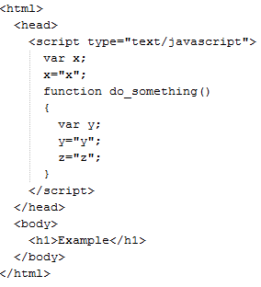
Evaluating expressions – cont.
What happens to the AH when
evaluating a variable access?
There are 3 kinds of variable
accesses:
  local JavaScript variables
  declared global JavaScript variables
  undeclared variables – automatically
  global

Slide 29


Evaluating expressions – cont.
Thus, first the existence property
x is checked in the current scope
  if it exists, the current node is the node
  of the variable, and so is the d part of AH
Otherwise, the global node is
checked for property x
-if it exists, the same happens

Slide 30
Evaluating expressions – cont.
Otherwise (not in the current or
global scope), a new node is created
and added to the global scope:
  a new heap location is created
  a new node is created
  its dependency is empty
  the existence property of x in the global
  heap is added to the fr
  the fact that the scope of the new node
  is the global heap, is added to “this-map”

Slide 31


Evaluating expressions – cont.
What happens to the AH when
evaluating a field access?
  if the variable x already exists in one of
  the heaps, and the field f of the node
  resulted from the variable access evaluation
  may be located in the field node, then:
  all the sets, maps and relations resulted by
  the evaluation are those of the AH resulted
  from the evaluation of the variable x
  only two additions: the current node is the one of the field, and the
  dependencies includes the program variables that flow into

Slide 32
Evaluating expressions – cont.
  Otherwise (if the variable x exists but the
field node doesn’t) a new is created
and added to the AH with the
variable x :
  a new heap location is created
  a new node is created
  the dependencies are those of the AH
  resulted from the variable evaluation
  the existence property of f in the AH with x is added to the fr
  the fact that the scope of the new node is the node representing
  x, is added to “this-map”

Slide 33
Evaluating expressions – cont.
What happens to the AH when
evaluating a binary operation?
  the new AH is the union of dependencies
  of both the expressions
  includes union of heap locations,
  dependencies, fr’s, dependency maps and
  “this-maps”. The current node is a new node
  representing the operation.

Slide 34
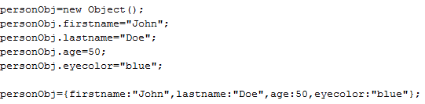

Evaluating expressions – cont.
What happens to the AH when
evaluating a object literal?
example:
  a summary is computed by recursively creating heap locations for each of its properties.

Slide 35
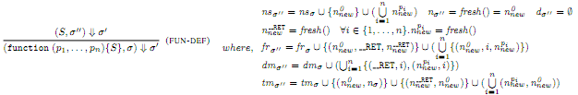
Evaluating expressions – cont.
What happens to the AH when
evaluating a function deﬁnition?
  like with object literals, except that new summary
  locations are created for each of the function
  arguments and also for the return variable.
  the function body is evaluated with respect to
  the new heap.
  the result of the evaluation is the new heap with the function summary attached to the node of the return value.

Slide 36

Evaluating expressions – cont.
What happens to the AH when
evaluating a function call?
  uses this summary to compute the node and dependencies of the return value.
  the return value of the function can be obtained by evaluating each of the function argument expressions, and replacing the appropriate nodes in the function summary with the values returned.
  if the function is not deﬁned, then the dependencies of the return values are the union of dependencies of the individual function parameters.

Slide 37
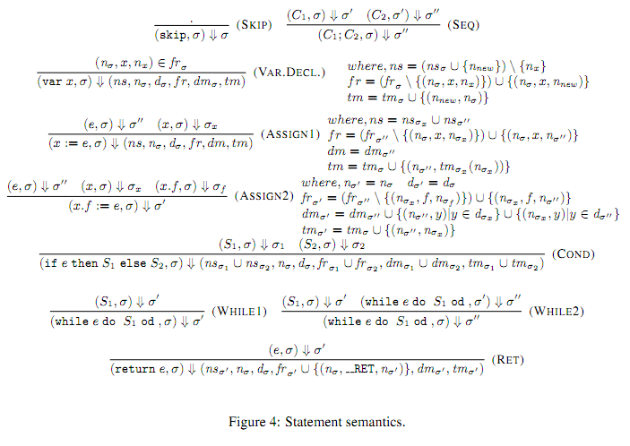
Evaluating statements

Slide 38


Evaluating statements – cont.
What happens to the AH when evaluating skip and sequence
statements?
What happens to the AH when evaluating a variable declaration?
  a new node is created in the current scope.
  if the heap node for that variable already exists, it is replaced by this new node.

Slide 39
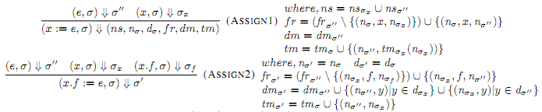
Evaluating statements – cont.
What happens to the AH when evaluating assignment
statements?
  the left hand side and the right hand side expressions are evaluated, and the node on the left hand side is replaced with the node on the right hand side.

Slide 40
Evaluating statements – cont.
What happens to the AH when evaluating conditionals?
  they are not evaluated as our heaps are symbolic
What happens to the AH when evaluating a return statement?
  If evaluation of e with the AH results in , then the AH after
  returning e is the same, with the emphasis on the change in fr.

Slide 41
Evaluating statements – cont.
What happens to the AH when evaluating while statements?
  while statements, like conditionals, are not evaluated as our heaps are symbolic
  the while body is evaluated until we reach a ﬁxed point (or until we reach a ﬁxed number of loop un-rollings)
  the abstract heap is also allowed to immediately go across a while-loop
The analyze begins with an initial state consisting of a global heap (with summaries for a few built-in objects like Array)
The evaluation of the rules either proceed until we converge on a least ﬁxed-point, or until we reach a preset bound on the number of iterations

Slide 42
Handling other features of JavaScript
Dynamic code (eval):
  an accurate analysis of the structure of dynamically created code is too complex
  furthermore, eval statements cannot be simply ignored
  VEX implements a static constant-string analysis for strings, and subject the strings that are eval-ed to this analysis
    Strings that are not statically known but subject to eval are essentially ignored
innerHTML:
  creating a symbolic representation of the source, computing summaries of innerHTML and allowing outside methods to instantiate the symbolic source to a concrete source in whichever context it becomes available.

Slide 43
Notes about the analysis
The analysis is:
Flow-sensitive: takes into account the order of statements in a program.
Path-sensitive: computes different pieces of analysis information dependent on the predicates at conditional branch instructions.
Context-sensitive: interprocedural analysis that considers the calling context when analyzing the target of a function call.

Slide 44
Notes about the analysis – cont.
Unsoundness:
  a static analysis tool like VEX is inherently conservative
  if VEX reports a ﬂow, there may be no such feasible ﬂow in the program (false positives)
Incompleteness
  false negatives are also possible because of several unsummarized objects
VEX has several sources of unsoundness and incompleteness:
  eval
  prototypes
  higher-order functions
  ﬁxed number of unrolls of loops
  exceptions

Slide 45
Evaluation: VEX implementation
VEX:
  is implemented in Java (2000 LOC)
  utilizes a JavaScript parser built using the ANTLR parser generator for the JavaScript 1.5 grammar.
  ANTLR outputs Java-based Abstract Syntax Trees (AST) for JavaScript ﬁles.
  VEX walks through the ASTs computing the ﬂow sets from all sources to all sinks, in a single pass analysis

Slide 46
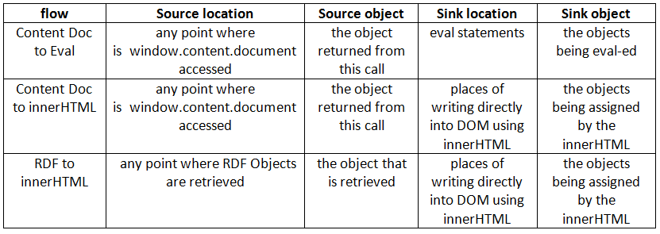
Evaluation - cont.
The current version of VEX checks these ﬂow patterns that capture ﬂows from injectable sources to executable sinks:

Slide 47
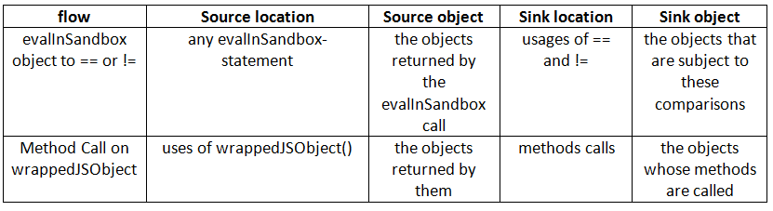
Evaluation - cont.
Furthermore, VEX searches for these patterns that characterize unsafe programming practices that could lead to security vulnerabilities:
The VEX tool can be adapted to other kinds of suspect ﬂows

Slide 48
Evaluation methodology
The experiment’s steps:
Chose a random sample of 1827 extensions from the Mozilla add-ons web site (ﬁrst extensions in alphabetical order for all subject categories)
Chose 699 of the most popular extensions
(74 extensions in common, total of 2452 extensions)
Extracted the JavaScript ﬁles from these extensions
Ran VEX on them, using a 2.4GHz 64 bit x86 processor with a maximum heap size of 4GB for the JVM

Slide 49
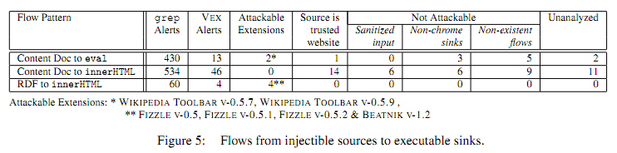
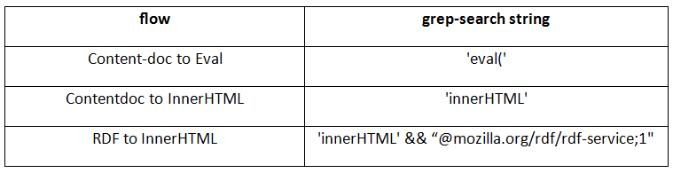
Experimental results
Finding ﬂows from injectible sources to executable sinks:
  on average, VEX took 15.5 seconds per extension

Slide 50

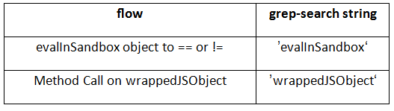
Experimental results – cont.
Finding unsafe programming practices:
  15 of the alerts were analyzed manually

Slide 51
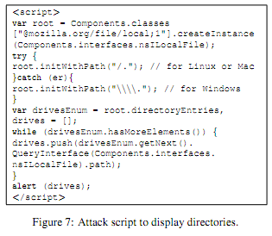
Successful attacks
Attack scripts example:

Slide 52
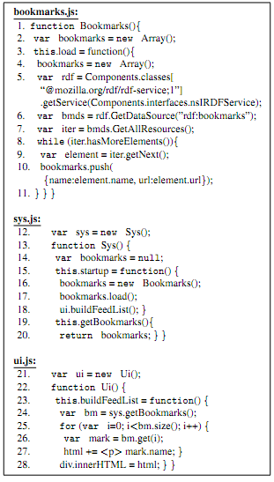
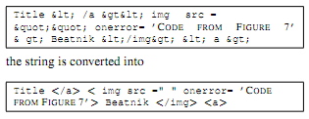
Successful attacks
Vulnerabilities founded by VEX:
Wikipedia Toolbar, up to version 0.5.9
Fizzle versions 0.5, 0.5.1, 0.5.2
Beatnik version 1.2

Slide 53
Conclusion
Advantages of VEX:
  VEX vets the ﬂows automatically
  greatly reduces the number of extensions that need to be manually reviewed
  15.5 seconds per extension instead of hours
  more accurate than manual review
  VEX performs the analysis only once and from the results, allow us to search for any source-to-sink ﬂow
  Flow-sensitive, path-sensitive, context-sensitive analysis

Slide 54
Conclusion – cont.
Disadvantages of VEX:
Unsoundness and incompleteness
  false positives and false negatives
The design choices aren’t necessarily optimal
No modeling of actual values
  conditional and while statements aren’t evaluated
The evaluation is executed until reaching a specific condition
No evaluation of prototypes
No evaluation of statically unknown strings subject to eval
There is no information about the existence of known vulnerabilities that VEX hasn’t detected

Slide 55
Future Work
A points-to analysis
  more precise on certain aspects of JavaScript such as higher order functions, prototypes, and scoping
Deﬁning a more complete set of ﬂow-patterns (sources and sinks) that capture vulnerabilities
Automatically building attack vectors for statically discovered ﬂows, by a constraint solver
  can help synthesize attacks (handling sanitization routines effectively)

Slide 56
תודה רבה!

