Slide 1
DieHard: Probabilistic Memory Safety for Unsafe Languages
By Emery D. Berger and Benjamin G. Zorn
Presented by: David Roitman

Slide 2
If so, DieHard comes to save you….

Slide 3
Index
Un/Safe Languages and DieHard
Probabilistic security and the Infinite Heap.
The M-Heap as an approximation
Implementation
Results
Conclusions
Questions

Slide 4
What is a safe program?
For the purpose of this article, a program is fully memory safe if it satisfies the following criterias:
It never reads uninitialized memory.
Performs no illegal operations on the heap
No invalid or double frees
Does not access freed memory
No dangling pointer errors.

Slide 5
Problems with Unsafe Languages
Unsafe languages like C and C++ are vulnerable to:
Dangling pointers
Mistakinly freeing a live object, which might be overwritten.
Buffer overﬂows
Writing more data then the target has room for.
Can corrupt the contents of live objects on the heap.
The iPhone and the PS3 were both hacked by exploiting this.
Heap metadata overwrites
If heap metadata is stored near heap objects, a buffer overflow can corrupt it.

Slide 6
Problems – Cont.
Unsafe languages like C and C++ are vulnerable to:
Uninitialized reads
Reading from newly-allocated or unallocated memory leads to undefined behavior.
Invalid frees
Passing illegal addresses to free can corrupt the heap.
Double frees
Repeated calls to free of objects that have already been freed cause freelist-based allocators to fail.

Slide 7
Current Approaches to safe programming
Failure oblivious – Does everything it can to avoid aborting.
Drops illegal writes
Makes up values for invalid reads
Unsound – Correct execution isn’t guaranteed.
Fail-Stop – Aborts any computation that might violate one of the safe program conditions
Provides soundness but crashes a lot.
This is how most safe C compilers work.

Slide 8
DieHard – A new approach
A runtime system that tolerates errors while probabilistically maintaining soundness.
Provides correct execution in the face of errors with high probability.

Slide 9
DieHard’s Modes of operation
Stand alone
Replaces the default memory manager.
Provides substantial protection against memory errors.
Replicated – An expansion of the stand alone mode.
Runs multiple replicas simultaneously, votes on results.
Detects crashing & non-crashing errors.
Adds detection of errors caused by illegal reads.
Both rely on the DieHard randomized memory manager.

Slide 10
The DieHard randomized memory manager
Places objects randomly across a heap whose size is M times the maximum required.
Separates all heap metadata from the heap
Avoiding most heap metadata overwrites
Ignores attempts to free already freed or invalid objects.

Slide 11
How does it help?
Reduces likeliness of crashes due to buffer overflows
The spacing between objects makes it likely that buffer overflows end up overwriting only empty space.
Helps avoid dangling pointer errors
Randomized allocation makes it unlikely that a newly freed object will soon be overwritten by a subsequent allocation.

Slide 12
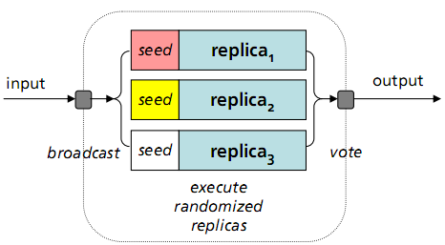
The replicated mode
Increases protection and adds detection of uninitialized reads.
Buffer overflows are likely to overwrite different areas of memory in the different replicas.
In this mode only, the heap and every allocated object is filled with random values.
An uninitialized read will return different results across the replicas.

Slide 13
Where we are?
Un/Safe Languages and DieHard
Probabilistic security and the Infinite Heap.
The M-Heap as an approximation
Implementation
Results
Conclusions
Questions

Slide 14
The infinite heap memory manager
Is an ideal, unrealizable runtime system that allows programs containing memory errors to execute soundly and to completion.
In such a system, the heap area is infinitely large and can never be exhausted.
All objects are allocated fresh, infinitely far away from each other, and are never deallocated.

Slide 15
What’s so good about it?
Buffer overflows become benign
Objects are so far apart that they never overwrite live data.
Dangling pointers vanish
Objects are never deallocated or reused.
However, uninitialized reads remain undefined.
This requires the replicated version.
This of course, is impossible to build!
DieHard approximates this behavior by using an M-heap.

Slide 16
The M-Heap
An M-heap is a heap that is M times larger than needed.
By placing objects uniformly randomly across an M-heap, we get an expected separation between any two objects of M-1 objects
Any overflow smaller than that becomes benign, with high probability.

Slide 17
The M-Heap – Cont.
Increasing the heap expansion factor (M) increases the probability of correct execution in the presence of memory error.
This heap thus provides probabilistic memory safety, a probabilistic guarantee that memory errors occurring in the program are benign during its execution.

Slide 18
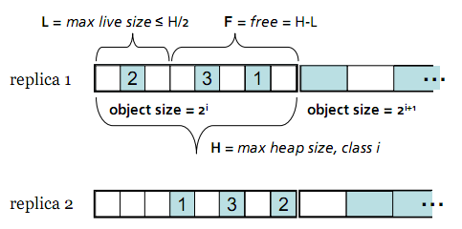
Organizing the Heap
The heap is logically partitioned into twelve regions, one for each power-of-two size class from 8 bytes to 16 kilobytes.
Each region is allowed to become at most 1/M full.

Slide 19
Larger then 16k?
DieHard allocates larger objects directly using mmap and places guard pages without read or write access on either end of these regions.
Object requests are rounded up to the nearest power of two.
Significantly speeds allocation by allowing bit shifting operations instead of divides.
These regions were created in order to prevent the fragmentation that would occur if all objects would be spread throughout the heap.

Slide 20
The heap Metadata
Includes a bitmap for each heap region
One bit always stands for one object.
All bits are initially zero, indicating that every object is free.
Also includes the number of objects allocated to each region (inUse).
Ensures less than 1/M objects per partition.

Slide 21
Location of the heap Metadata
Most allocators store heap metadata in areas immediately adjacent to allocated objects.
These are known as boundary tags.
A buffer overflow of just one byte past an allocated space can corrupt the metadata and thus the heap.
DieHard keeps all of the heap metadata separate from the heap, and thus protects it from buffer overflows.

Slide 22
Where we are?
Un/Safe Languages and DieHard
Probabilistic security and the Infinite Heap.
The M-Heap as an approximation
Implementation
Results
Conclusions
Questions

Slide 23
Part 1 - Initialization
The initialization phase obtains free memory from the system using mmap.
The size allocated is M times larger then needed.
The random number generator’s seed is initialized with a true random number.
For example /dev/urandom in Linux
For the replicated version only, the initialization phase then uses its random number generator to fill the heap with random values.

Slide 24
Initialization – Pseudo code
Setting the random seed
Resetting the bitmap in the metadata
Allocating the heap
In replicated mode - Filling the heap with random values

Slide 25
Part 2 - Malloc
Diehard overrides the native malloc and free functions with it’s own version.
The allocator first checks to see whether the request is for a large object (>16K).
If so, it calls allocateLargeObject() which
Allocates the object Using mmap.
Stores the address in a table for validity checking by DieHard’s Free.

Slide 26
Malloc If <16K
Finds which class it belongs to using
If the class is not full it looks for an empty space similarly to probing a hash table.
It then marks the object as allocated and increments the allocated counter.
Again, for the replicated version, fills the object with randomized values.

Slide 27
Malloc – Pseudo code
If >16K allocate large
Check if full
Probe for empty slot
If found, mark allocated
In replicated mode - Filling the object with random values

Slide 28
Part 3 - Free
DieHard’s Free takes several steps to ensure that any object given to it is in fact valid:
Checks if the address is inside the heap area.
If not, it might be a large object and is sent to freeLargeObject() which checks the large address table.
The object must also be currently marked as allocated.
Only if both conditions are met, the object is freed from the heap.

Slide 29
Free – Pseudo code
If not in heap area, it’s large
Checks both conditions before freeing
Mark as unallocated

Slide 30
Fixing strcpy()
Another change DieHard does is replace the error prone strcpy() function with it’s own variant.
Strcpy() does no checks to verify that the target has enough room for the string.
DieHard also replaces its “safe” counterpart, strncpy.
Same as strcpy but also requires the size of the string to copy.
Still does no checks to verify the target has room for it.
DieHard’s version checks the destination’s actual available space and uses that value as the upper bound.

Slide 31
Where we are?
Un/Safe Languages and DieHard
Probabilistic security and the Infinite Heap.
The M-Heap as an approximation
Implementation
Results
Conclusions
Questions

Slide 32
A little probability
Definitions:
M - heap expansion factor.
K – Number of replicas.
H – The maximum heap size.
L - The maximum live size.
F - The remaining free space. F=H-L
O – The number of object’s worth of bytes overflowed.

Slide 33
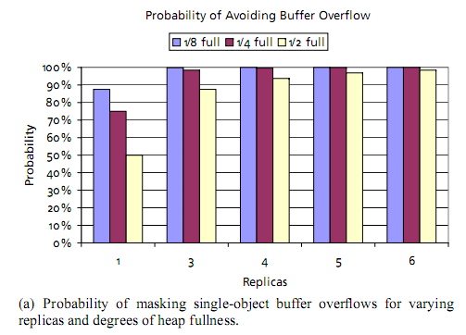
Masking Buffer Overflows

Slide 34
Masking Dangling Pointers

Slide 35
Performance on Linux
For allocation-intensive benchmarks, DieHard suffers a performance penalty ranging from 16.5% to 63%.
geometric mean: 40%
However, DieHard’s runtime overhead is substantially lower for most of the SPECint2000 benchmarks.
The geometric mean of DieHard’s overhead is 12%.

Slide 37
Performance on Windows XP
The results on Windows XP are much better and are effectively the same as with the default allocator.
These results can be attributed to two factors:
The default Windows XP allocator is substantially slower than the Lea allocator.
Visual Studio produces much faster code for DieHard than g++ does.

Slide 39
Replication overhead performance
Running 16 replicas on 16 different cores simultaneously
Increases runtime by approximately 50%.

Slide 40
Error Avoidance
Errors were injected into running benchmarks and results were compared between the regular allocator and Diehard.
For injection of a dangling pointer for every other free
The espresso benchmark could not run to completion with the default allocator in all runs.
With DieHard it ran correctly for 9 out of 10 runs.
The same for 1 out of every 100:
With the default allocator, espresso crashes in 9 out of 10 runs and enters an inﬁnite loop in the tenth.
With DieHard, it runs successfully in all 10 of 10 runs.

Slide 41
Real application testing
Version 2.3s5 of the Squid web cache server has a buffer overflow error.
Running it using the default allocator crashed with a seg-fault.
Running it under DieHard in stand-alone mode was completed successfully.

Slide 42
Where we are?
Un/Safe Languages and DieHard
Probabilistic security and the Infinite Heap.
The M-Heap as an approximation
Implementation
Results
Conclusions
Questions

Slide 43
Conclusions
DieHard is a runtime system that effectively tolerates memory errors and provides probabilistic memory safety.
DieHard uses randomized allocation to give the application an approximation of an infinite-sized heap.
Uses replication to further increase error tolerance and detect uninitialized memory reads.

Slide 44
Conclusions – Cont.
DieHard allows an explicit trade-off between memory usage and error tolerance.
Is useful for programs in which memory footprint is less important than reliability and security.
Like garbage collection, DieHard represents a new and interesting alternative in the broad design space that trades off CPU performance, memory utilization, and program correctness.

Slide 45
Questions?

