Slide 1





Publish-Subscribe Approach to Social Annotation of News
Top-k Publish-Subscribe for Social Annotation of News
Alex Shraer
Joint work with:
Maxim Gurevich (RelateIQ)
Marcus Fontoura, Vanja Josifovski (Google)
Work done while authors were at Yahoo! Research
Notes:
1
1

Slide 2

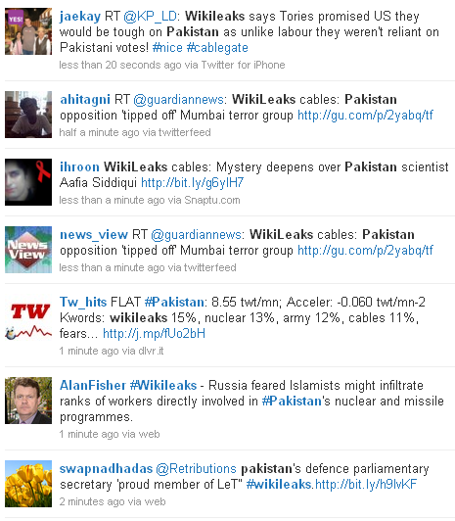
News & Social Updates

Slide 3
News Annotation
Goal: Annotate each story with k most related tweets
Challenges:
  Automatic matching, based on content of story & tweet
  Real time - continuously update annotations
  Serving Latency - avoid delay in serving the news page
  High scale – billions of page views per day,
  hundreds of millions of tweets per day,
  tens of thousands of stories per day

Slide 4
Real-time Index Approach
Maintain a tweet index in real-time
For every page view in the media site, query this index with the content of the story as the query
Problems:
  Long queries, serving time affected
  The index is queried and updated very frequently
  Caching techniques almost unusable
Not scalable!
top-k tweets
Tweet
Index
Page view
Billions per day
story
Hundreds of millions per day
update
New tweet

Slide 5
Our solution: Top-K Publish-Subscribe
Treat stories as subscriptions, tweets as published items
New item triggers a subscription only if it is among the top-k matching items published so far
Page view
story
top-k tweets
Story to top-k tweets map
Story
Index
New tweet
update
query
update
New story
Notes:
This design has three main scenarios: (1) for every new tweet we use it to query the Story index and, if it is part of the top-k results for that story, we add it to the “storyID -> { tweet list }” mapping. We also add the new tweet to the tweet index; (2) for every new story or story update we query the Tweet index and retrieve the top-k tweets, which are used to update the mapping. We also add the new story/story update to the Story index. For every page view in the Y! media site we simply retrieve the top-k tweets from the mapping.

Slide 6
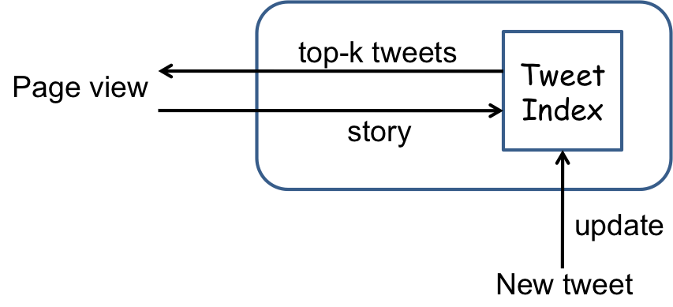
Real Time Indexing VS Top-k Pub-Sub
Real-time indexing Publish-Subscribe
Computation 1B ⋅ 50ms = 50Bms 100M⋅10ms+1B⋅1ms = 2Bms
Serving time 50ms 1ms
  #cores 600 12 + 12 = 24
  1B pageviews/day =>
  ~600 pageviews/50ms
1B pageviews
100M
Story to top-k tweets map
10K
Story
Index
1B pageviews
50ms
1ms
10ms
X 25
X 50
X 25
Story Index
100M tweets/day =>~12 tweets/10ms
1B pageviews/day =>
~12 pageviews/1ms
Top-k map

Slide 7
Standard IR Index and Algorithms
  Posting list for term t: a list of partial scores,
  one for each document containing the term t
  Query q = <t₁, t₃, t₄>
  Go over posting lists for
  t₁, t₃, t₄
  Collect partial scores, when
  done we have fully scored documents
  w.r.t. the query q
  Return k documents with maximal score
Documents
s₁
s₃
s₄
s₇
s₉
s₁₀
s₁₁
s₁₈
s₃₁
s₃₇
t₁
s₂
s₃
s₄
s₇
s₈
s₁₈
s₁₁
s₁₈
t₂
s₃
s₈
s₉
s₃₂
terms
t₃
s₄
s₅
s₇
s₁₂
s₁₃
s₁₅
s₂₁
s₂₂
s₃₄
s₃₅
t₄
s₆
s₈
s₁₃
s₁₄
s₁₉
s₂₂
s₂₅
t₅

Slide 8
Story Index and Top-k Pub-Sub Algorithms
  Posting list for term t: a list of partial scores,
  one for each story containing the term t
  tweet = <t₁, t₃, t₄>
  Go over posting lists for
  t₁, t₃, t₄
  Collect partial scores, when
  done we have fully scored stories
  w.r.t. the query q
  For every story s with score(s, tweet) > 0, attempt to insert tweet into annotation set of s
    Compare score(s, tweet) to score of the k tweets currently annotating s
Stories
s₁
s₃
s₄
s₇
s₉
s₁₀
s₁₁
s₁₈
s₃₁
s₃₇
t₁
s₂
s₃
s₄
s₇
s₈
s₁₈
s₁₁
s₁₈
t₂
s₃
s₈
s₉
s₃₂
terms
t₃
s₄
s₅
s₇
s₁₂
s₁₃
s₁₅
s₂₁
s₂₂
s₃₄
s₃₅
t₄
s₆
s₈
s₁₃
s₁₄
s₁₉
s₂₂
s₂₅
t₅

Slide 9
Our contribution
Method to convert efficient IR algorithms into efficient top-k pub-sub algorithms
  Demonstrate on 4 standard IR algorithms
  TAAT, Buckley & Lewit, DAAT, WAND

Slide 10
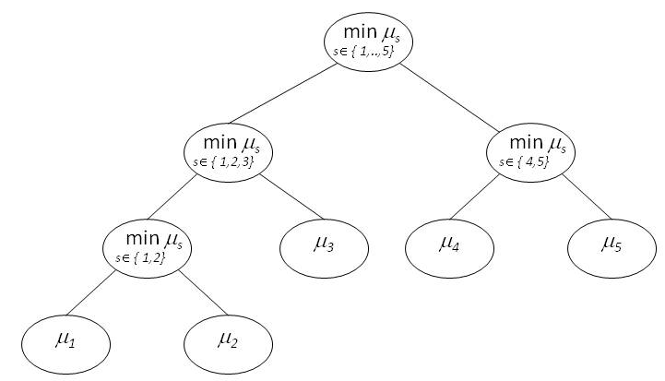
Key for Efficiency: Skipping
  IR algorithms skip most of the posting lists
    Compute upper bound on score gain in all remaining posting lists
    If upper bound is not enough to change result set, can skip remaining lists
  Can’t use this for pub-sub – instead of 1 result-set we have to update many
  μ_{s} - score of worst tweet annotating a story s
    Skipping condition when processing a tweet:
    Can skip s only if upper bound on score(tweet, s) ≤ μ_{s}
    Use a segment tree per posting list to skip segments of the list that satisfy skipping condition
    Overhead ~1.6% of index size
s₁
s₂
s₃
s₄
s₅
t₄
Score of worst
Tweet annotating
story s₁

Slide 11
Score(story, tweet)
Content based matching (cosine similarity, BM25)
Time-based decay factor
  every τ time the score is divided by 2
Notes:
We also show experiments with BM25
Observation 1: As time passes, relative ranking between
scores of past tweets does not change
Observation 2: No need to apply decay on past tweets
Can just multiply score of new tweet by

Slide 12


Test Collection
100K articles from a single day
  Each article has title, abstract and main body
35M from same day containing only ASCII chars
  24K/minute

Slide 13
Fraction of related tweets that actually matter
We measured: 38 new tweets related to average story per minute
For 100K stories: 3.8M tweets / minute
  This would be #invalidations in real-time indexing w/caching
    Many (expensive) queries of Tweet Index or, alternatively, stale annotations
Fraction of related tweets that actually become annotations:
      5 orders of magnitude less!
Important to efficiently identify stories the tweet will actually annotate

Slide 14
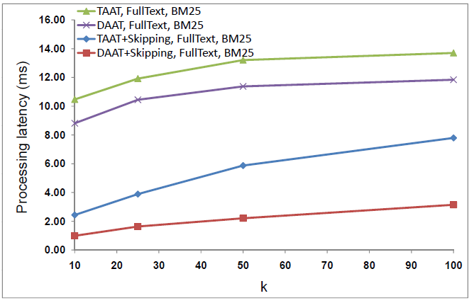
Skipping: 10x reduction in processing time
Our alg. w/o skipping
Our alg. with skipping

Slide 15
Summary
Annotating news stories with social updates in real time
  Top-k pub-sub: stories indexed as subscriptions, tweets are events
  Scalable, fast annotation serving
  Low latency tweet processing, off the critical serving path!
Method to convert top-k retrieval alg. to top-k pub-sub
  Demonstrate using 4 popular algorithms
  Skipping works - up to 10x latency reduction
Can use top-k pub-sub for ‘top’ stories, caching for others
Many potential applications
  Examples: alerts, personalized news feed, etc.

Slide 16
Thank you!
Alex Shraer
shralex@google.com

